Slide 1
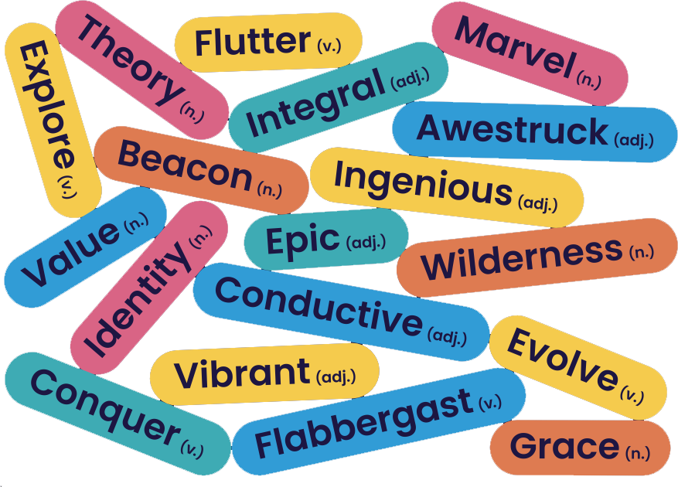
Bedrock Learning brings you… a sideways look at Christmas
Merry Christmas Everyone

Slide 2
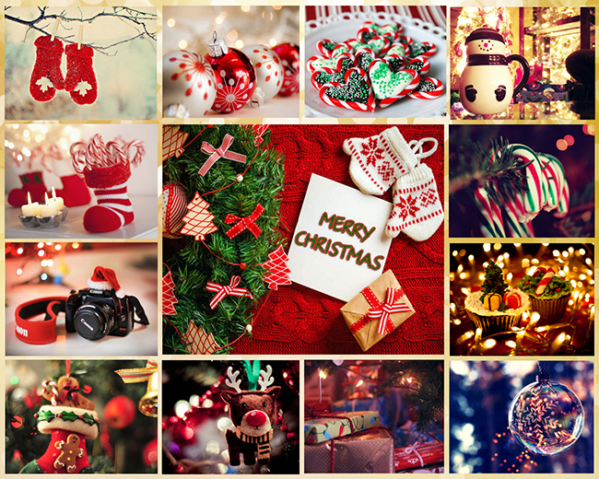
As Christmas approaches, what’s the one thing you most look forward to?
Nearly there…
Activity 1

Slide 3
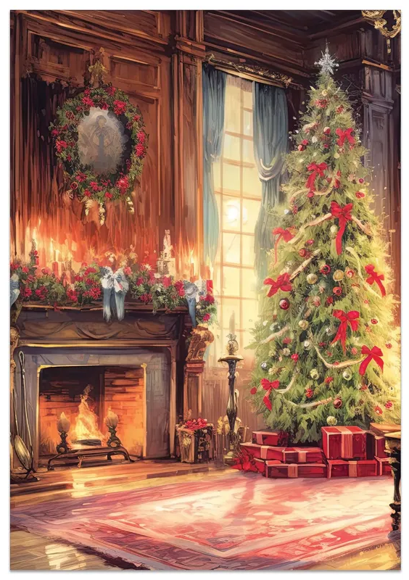
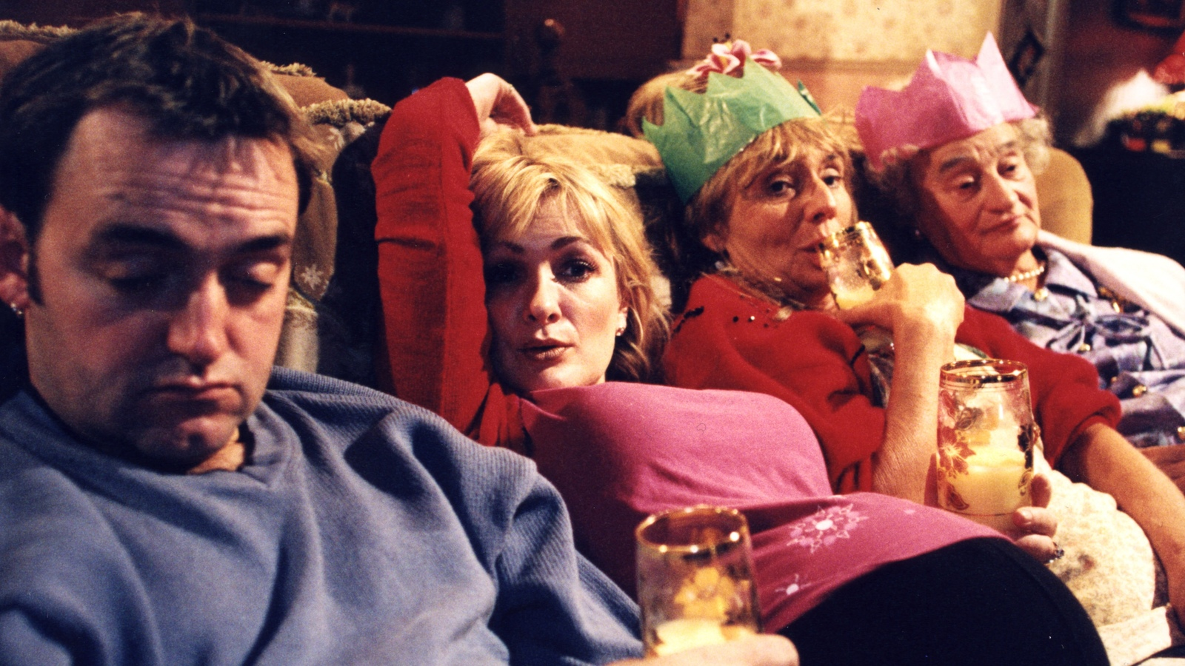
But… let’s be honest… which is more accurate?
Does it matter?

Slide 4
The noun ‘tradition’ has Latin roots in the word tradere, which means hand over or hand down.
What is ‘tradition’ anyway?
Activity 2
What’s been handed to you?
What will you pass on?

Slide 5
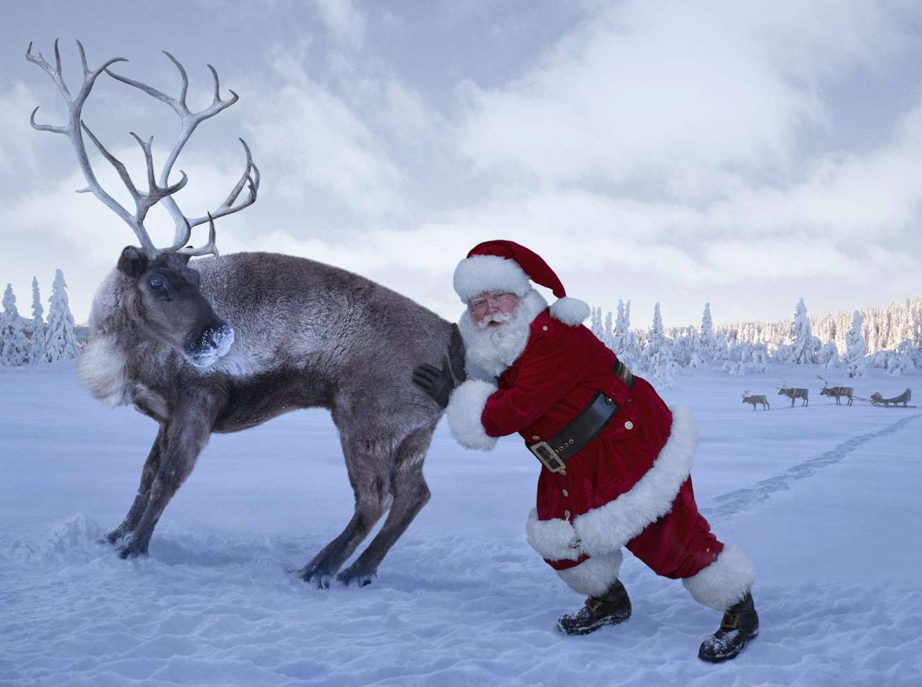
Write a lively, entertaining article for your school website entitled:
“The Festive Season with the ___” (insert family name)
A sideways look at Christmas: your task

Slide 6
Let’s get down to it
Get up time?
Food?
Eating times?
Guests?
Leaving the house?
Neighbours?
Games?
Films?
“The Festive Season with the ____”
Activity 3

Slide 7
Write a lively, entertaining article for your school website entitled, “The Festive Season with the ___” (insert family name)
How are we going to be successful?
How will this purpose influence your language choices, including words and sentences?
How will this genre your language choices, including words and sentences?
How will this audience your language choices, including words and sentences?

Slide 8
Let’s make a list of key things to remember when it comes to each of these things…
How are we going to be successful?
How will this purpose influence your language choices, including words and sentences?
How will this genre your language choices, including words and sentences?
How will this audience your language choices, including words and sentences?
Activity 4

Slide 9
How are we going to be successful?
Activity 4
How will this genre your language choices, including words and sentences?
Key Features of an article/blog
A catchy/punchy title
A range of paragraph lengths
A minimum of 4 paragraphs/ideas
Suggested structure: sharp, one line opening, the uniqueness of Christmas in your house, your overall thoughts about Christmas, your key Christmas message
How will this purpose influence your language choices, including words and sentences?
Lively/entertaining purpose
Engaging with the reader directly
Informal language
A range of openers
Exaggeration/tone words
How will this audience your language choices, including words and sentences?
Lively/entertaining purpose
Who are you writing for? One audience? More than one?
What might cause controversy/debate between these people?

Slide 10
A catchy, punchy title
A sharp, one line opening
The uniqueness of Christmas in your house
Your overall thoughts about Christmas
Your key Christmas message
A plan…
discuss your ideas here
Activity 5

Slide 11
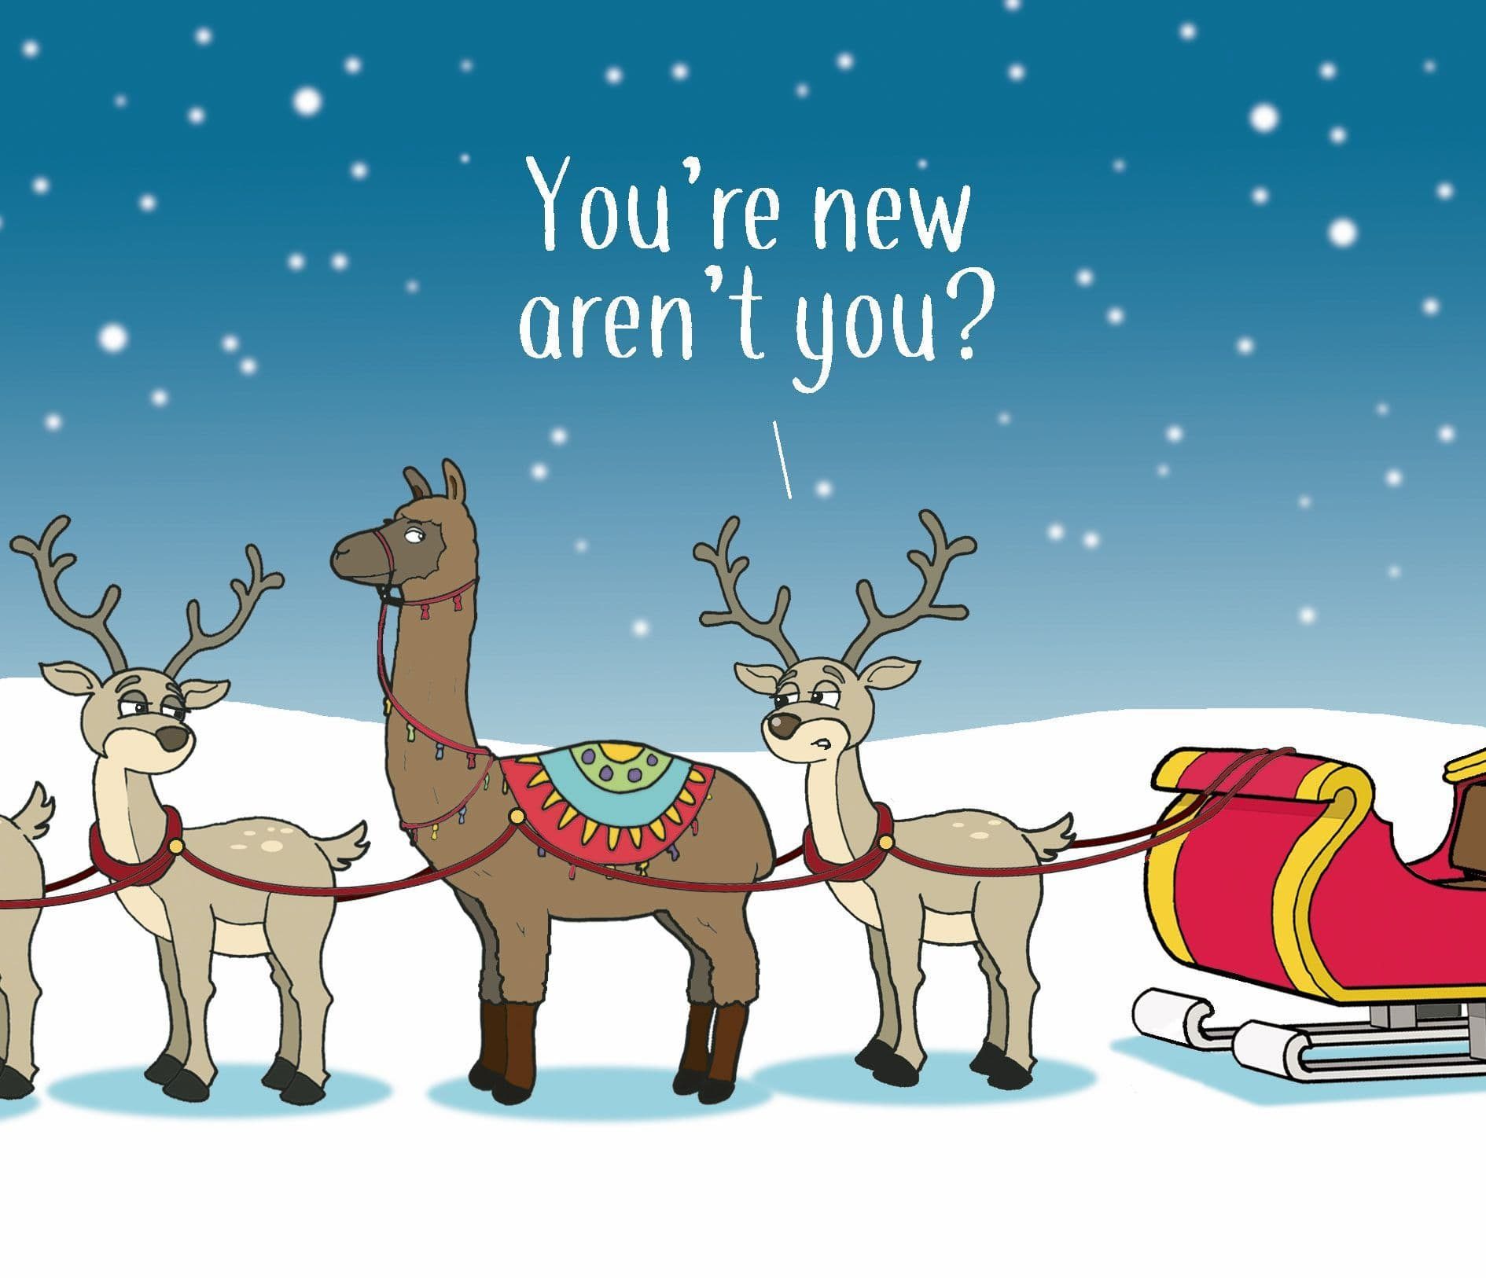
A catchy, punchy title
___, ___, and ___: The Festive Season with the ____
The most ___ time of the year.
A sharp, one line opening
It usually begins when…
In my family, Christmas starts roughly when…
The uniqueness of Christmas in your house
Now, I bet in your house you don’t….
I suppose Christmas is uniquely marked in the ___ household because___
Your overall thoughts about Christmas
Basically, though, for us, Christmas is a time of… Of… Of….
If nothing else, Christmas is about…
Your key Christmas message
So, dear reader, I leave you with one thought: _____
I’d love for you to take one thing away with you: ____
A plan… suggestions…

Slide 12
I like christmas because I can stay in my pyjamas and watch TV.
We wake up early and have a nice breakfast.
Then my family comes and we play games and I love being together.
What went well?
Even better if…
Attempt 1:
Activity 6

Slide 13
A guide to The Festive Season with the Smiths.
5:30. Always 5:30. My mum swears it’s more like 4:00, but I think she’s exaggerating.
Frankly, I don’t see the problem with either time in any case. It’s only once a year anyway.
After about 10 minutes of relentless pestering, my dad is usually dragged from the safety of his bed. My sister and I then proceed to form what can only be described as a scrum as we descend the stairs, and into the promised land.
What then ensues can only be described as the most ecstasy packed day of the year.
What went well?
Even better if…
Attempt 2:
Activity 6

Slide 14
A guide to The Festive Season with the Smiths.
5:30. Always 5:30. My mum swears it’s more like 4:00, but I think she’s exaggerating.
Frankly, I don’t see the problem with either time in any case. It’s only once a year anyway.
After about 10 minutes of relentless pestering, my dad is usually dragged from the safety of his bed. My sister and I then proceed to form what can only be described as a scrum as we descend the stairs, and into the promised land.
What then ensues can only be described as the most ecstasy packed day of the year.
Attempt 2:
This is a fragment, which is an ungrammatical sentence.
You wouldn’t see it in formal writing, but why does it work in this case?
Why would the perspectives differ here? And why is it useful/entertaining to have this? Think about the audience…
This is known as a disjunct- other examples are Fundamentally, Ultimately, Honestly, Fortunately.
Why are these useful to support you to create tone?
These are adjectives. If you remove them, how does it impact upon the tone of the piece?
These are metaphors: the writer has deliberately chosen them from other topics.
Identify the topic where they have been taken from
Explain why the writer has made this choice

Slide 15
Let’s write our opening paragraph together
It’s the most wonderful time of the year again. Or,in my house, the most _____ time of the year.
To be honest, ____
For the ___ family, Christmas is best described as a time of ___
Include a metaphor describing the day (bombs/fire/explosions might be helpful!)
I suppose I wanted to write this blogpost so that you ____
Slow writing…
Activity 7

Slide 16
You have:
A plan
A great example
A word bank
Some sentence openers
Let’s make the magic happen!
Over to you…!
Activity 8

Slide 17
Give your partner some supportive, constructive feedback
I really liked how you…
Specifically, I liked the word/line ‘___’
Could you have also thought about including more about ___
Peer feedback

Slide 18
Thank you

